Slide 2
2017 A levels in Mathematics and Further Mathematics:
Opportunities and Risks
Kevin Lord
FMSP Programme Leader
kevin.lord@mei.org.uk

Slide 3
Overview
The Further Mathematics Support Programme
Current state of A level Mathematics and Further Mathematics participation and provision in schools
Entry requirements for higher education
Changes to A level –structure, content and funding
Risks and opportunities
Action for university mathematics departments

Slide 4
What are the FMSP’s aims?
Increase participation in AS/A level Mathematics and Further Mathematics, particularly that of girls
Increase capacity within schools and colleges to provide high quality mathematics teaching
These aims support the principle that
all state-educated students throughout England should be able to access the mathematics education they need to fulfil their aspirations
Notes:
FMSP, previously Further Maths Network, has been government funded for over 10 years.
Its remit has widened to encompass increasing participation for single A level Maths as well as Further Mathematics but the principle remains essentially the same.

Slide 5
Overview of the FMSP’s work
Promotion of mathematics and the benefits of taking the mathematics A levels
Professional development to improve expertise in teaching 14-19 mathematics
Development of online provision to help ensure access to high-quality resources and tuition for A level Mathematics and Further Mathematics
Notes:
In 2015-16 the FMSP has provided enrichment to over 120000 secondary students, promoting A level Maths and Further Maths. Last year we produced a leaflet for students which has recently been updated.
We also work with over 3000 teachers each year to develop their subject knowledge, ensure that mathematics is taught well so students continue studying Maths and also that there is sufficient capacity to cope with demand for A level.
We have a reach of around 2500 registered schools in England

Slide 6
Access to Higher Education
Liaison with higher education to encourage clearer signaling of the importance of studying AS/A level Mathematics and Further Mathematics to support the transition to undergraduate study across a range of subjects
Resources and support for students’ mathematical preparation and transition to degree level study
Communicating to schools/colleges and students the mathematics requirements for entry to a range of degree courses and careers
Notes:
We know that HE is a key driver of demand for studying Maths and Further Maths, so we have focused on liaising with HE to ensure that there is information for students and their teachers of the need to be prepared mathematically for degree study.
In 2012 we began monitoring entry information. We also provide information and resources on our website and through enrichment events to make sure students are properly prepared.

Slide 7
Notes:
Last time there was a major curriculum change in 2000, entries for Mathematics and Further Maths dropped dramatically
Since this low point in 2002/03 the numbers taking A level Maths have increased and have recovered past the levels pre- curriculum 2000.
In the last 10 years entries have almost doubled and are around the 90 000 mark.

Slide 8
Notes:
The “recovery” of Further Maths has been even more impressive. Over the last 10 years, each year it has been one of the fastest growing A level courses, with entries almost trebling.
Entries are now around 15 000 each year.
AS Further Maths is also growing dramatically. When the specifications were changed in 2008 to facilitate AS to be taught alongside A level, entries increased more rapidly.

Slide 9
Provision in state-funded institutions
Notes:
Alongside the growth in participation has been the improvement in provision and access to Further Maths tuition. Last year out of all state-schools offering A level Maths, 67.5% had students taking Further Maths. Access to provision is likely to be even better than that. Compare this with 2004 when only 40% of centres offered Further Maths.
More schools are setting up 6th form provision but centres with Further Maths provision is increasing at a faster rate.
Any student who needs or wants to take further maths has much better opportunity to do so. The FMSP provides the “safety net” for those students in schools/college unable to offer Further Maths.

Slide 10
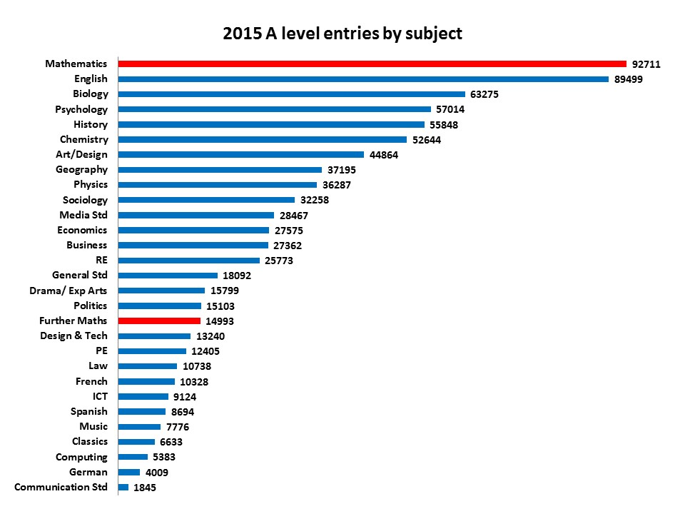
Popularity of Mathematics
Notes:
In spite of a number of reports suggesting that maths is unpopular, the reality is that for the past 2 years A level Maths has had the most entries of all A level subjects.
Further Maths over the last 10 years has climbed the league table to be in 17th place ahead of all languages, law, PE and design technology. No longer can we say Further Maths is for an “elite” few.

Slide 11
HE entry requirements - Mathematics
G100 course entry requirements
AS/A level Further Mathematics | No. | %
Required | 6 | 9%
Preferred/recommended | 19 | 28%
Mentioned in optional subjects | 5 | 7%
Not mentioned | 37 | 55%
Total number of courses | 67
FMSP, December 2014
Notes:
So the situation for 16-19 mathematics is currently quite healthy.
HE is provides a major pull and greatly influences students choices of A levels. Since 2012 the FMSP has been monitoring entry requirements to provide information to schools and students of the importance of studying Further Maths.
However the evidence is not clear in online information and prospectuses. Only 25 G100 course require or indicate that taking Further Maths is desirable. Over half of courses make no mention at all of Further Maths.

Slide 12
Undergraduate Entries - G1 Mathematics
University Academic Year | Total number of students accepted onto degree course | Total number of students accepted to G1 Mathematics courses who studied A Level (A2) Further Mathematics | Percentage of those accepted to G1 Mathematics courses who studied A levels that studied A Level (A2) Further Mathematics
2005/06 | 5041 | 1503 | 35.6%
2006/07 | 5349 | 1756 | 39.3%
2007/08 | 5861 | 1935 | 40.3%
2008/09 | 6403 | 2250 | 40.2%
2009/10 | 6916 | 2454 | 40.3%
2010/11 | 7276 | 2855 | 42.9%
2011/12 | 7585 | 3055 | 47.5%
2012/13 | 7311 | 3006 | 50.1%
2013/14 | 7699 | 3832 | 59.6%
Source: UCAS
Notes:
The demand may not be clear for HE maths departments but the supply is growing and UCAS data shows that these students are entering university maths courses in increasing numbers and proportion. More students are studying Mathematics at university and more are entering having studied A level Further Mathematics.
The percentage of those accepted onto G1 Mathematics courses who have studied A levels and who also have A level Further Mathematics, has increased from 35.6% in 2005/06 to almost 60% in 2013/14.
Similarly there have been increases in the proportion of students with Further Maths in Physics and Engineering degrees.

Slide 13
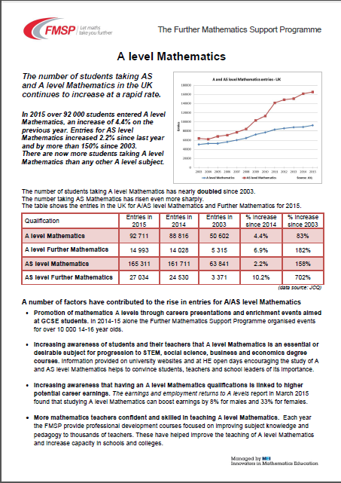
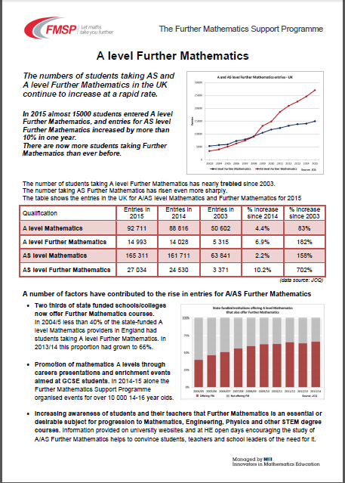
Liaison meetings with HE in 2015-16
99 courses contacted based on entry information
18 courses have indicated they will provide more encouragement for Further Mathematics
4 courses to require or encourage Mathematics.
Briefings for HE
Notes:
The FMSP is working to spread the good news of the improvements in the pool of students with A level Maths and Further Maths qualifications. This year we contact almost 100 HE courses to discuss their entry information and suggest ways to encourage the study of Maths and Further Maths.
There have been some successes with 18 departments agreeing to include more encouragement for Further Maths, only 4 for Maths

Slide 14
Helpful university examples
"AS or A2 Further Mathematics are not essential but will be helpful to our students. We are therefore generally more flexible with applicants who have studied Further Mathematics.”
“We encourage you to take A-level Further Mathematics if it is available to you, and we collaborate with the Further Mathematics Support Programme (link is external). Whilst we don't give an explicitly lower offer for people taking Further Mathematics, we will take it into account if you narrowly miss our offer.”
“Applicants offering an A-Level in Further Mathematics or another numerate subject (Physics, Chemistry, Economics, Computing), AS-Level Further Maths at grade A, Edexcel AEA (Advanced Extension Award), or Cambridge STEP (Sixth Term Examination Paper) will usually be given the lower offer (AAB).”
Notes:
We are not asking for Further Maths to be made a requirement, but wording can be added to indicate that Further Maths is useful/desirable/helpful.
These examples all help provide evidence to schools and students that they should think about taking Further Maths.

Slide 15
Changes to A level – AS levels
All A levels will be linear – i.e. no modules
Some new A levels started in September 2015, Mathematics starts from September 2017
AS is a separate examination which does not count towards the A level
AS is the first half of A level, but UCAS tariff for AS levels is 40% of A level tariff (not 50%)
Schools/colleges beginning to stop offering AS levels
Students take only 3 A levels from year 12 rather than starting with 4 AS levels, reducing to 3 A2s
Notes:
Following a review of A levels, they have been reformed. There will be no modules. All A levels assessed at the end of 2 year course.
Some reformed A levels started last September, Maths was pushed back to start in Sept 2017.
Other key changes is AS is still half content of A level but results in AS do not count towards A level grade.
AS tariff decreased.
Evidence from a small survey of 100 responses from schools/colleges in March 2016 – number of subjects that year 12 students start with is reducing to 3 as schools/colleges stop offering AS levels.
Students forced to choose courses that they will follow for 2 years at start of year 12.

Slide 16
2017 A level Maths and Further Maths
New specifications start in September 2017
First examinations in Summer 2019
Builds on the new GCSE Mathematics which started in September 2015
Draft specifications submitted on 9th June 2016
Notes:
New GCSE Mathematics specifications started in Sept 2015, current students will take GCSE in 2017 and then progress to new A level specifications.
2019 will be first cohort entering university with new A levels in Maths and Further Maths.
We will get first look at the specifications in June 2016 but these will not have been accredited.

Slide 17
2017 A level Mathematics
100% content specified by DFE – same for all boards
All students will have studied the same content
Pure Mathematical techniques, (66%)
Mechanics (17%) and
Statistics (17%)
Greater emphasis on
Reasoning and Proof
Problem-Solving and Modelling
Use of technology must permeate the study of A level Mathematics
Notes:
What we currently know is quite clear for Mathematics A level.
All students will have studied the same content regardless of the school or exam board. Similar pure methods content to current A level, but no choice of application.
Mechanics is similar to current M1 modules with a little content from M2
Statistics is more different, content from S1 and S2 with some S3 topics. A key difference is the expectation to work with large data sets using spreadsheets and other technology, cleaning the real data etc.
Assessment objective focus more on proof, reasoning, modelling and problem solving but not yet clear exactly how exam boards will assess these. Likely to be 2 or 3 terminal papers for the whole course.

Slide 18
2017 A level Further Mathematics
50% content specified, all pure
Awarding bodies can decide on the other 50% so they may (or may not) be significant differences
There may be some element of choice for schools/students
Further Mathematics should still be able to be taught alongside Mathematics
Awarding bodies choose, may be pure or applied
Compulsory content, all pure.
Notes:
There is a increased core of pure methods in Further Mathematics 50% compulsory compare with less than 20% at present.
Remaining content is determined by the exam boards, but there is likely to be a wide choice of options – further pure, mechanics, stats, decision maths and perhaps over applications.
The second page of the handout shows the 50% core content.

Slide 19
2017 AS level Further Mathematics
A level FM
Designed to be a separate, valuable qualification
AS Further Mathematics must be at least 30% Pure Mathematics with some compulsory content:
Matrices
Complex Numbers
Awarding bodies choose, may be pure or applied
AS level FM
Compulsory content, all pure.
Optional board prescribed content
Compulsorycontent
Notes:
It may be useful to think of the new AS level as being similar to the current AS, in that it is approximately one third (30%) pure and likely to be two thirds applied. The compulsory content will include matrices and complex numbers.

Slide 20
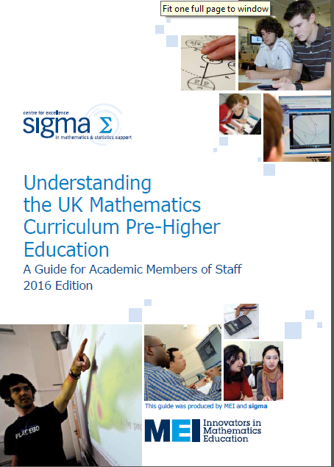
Updated guide to pre-university maths courses is being published by Sigma soon
New A level Specifications for maths available from 9th June (unaccredited)
Notes:
MEI and Sigma have updated the guide for HE staff about pre-university maths qualifications. This is being printed (April 2016) and will be available from sigma.

Slide 21
Changes to A level – Funding
2015 - new funding arrangements for post-16 students
c. £4000 per year for a student following a full-time course
Funding is for a programme equivalent to just over 3 A levels, instead of per subject taken
10% uplift available for students following a large programme (equivalent to 4 A levels) but only if they achieve A*- B in all subjects
Schools/colleges reducing number of A levels offered
Minimum class size for viable groups is increasing
Further Maths often a 4th option and low numbers
Notes:
At the same time as the curriculum changes at A level, post-16 funding has changed.
Previously schools/colleges were funded per student per subject they took – more subjects = more funding. New funding is per student and is about £4000 for a full-time programme. This is equivalent to about 3 and a bit A levels. There is some extra funding if students study 4 or 5 A levels but only if they succeed in getting high grades in all the subjects.
As a result this is having an impact on the number of subjects students can take. Also class sizes are rising in schools and colleges, and smaller classes are not running at all.
This is not good news for Further Maths – often a 4th choice for students and in many schools there are only very small numbers wanting to take Further Maths.
The FMSP is advising schools all the time how to run Further Maths “economically”.

Slide 22
Opportunities
Currently supply of A level Further Mathematics students (c.15 000) is meeting demand from HE STEM courses
Access to provision for Further Mathematics in schools, colleges and through FMSP has never been better
New A level courses starting in 2017
Changes to AS levels and funding may result in reduction in A level subject choice and offer to students
Studying 3 A levels leaves room in the timetable for enrichment such as EPQs, Core Maths, and AS/A level Further Mathematics
Notes:
The state of 16-19 mathematics participation and provision is very healthy at the moment.
New A level courses need to be promoted well to students, but for HE there will be more consistency in the prior knowledge of students who have A level Maths and Further Maths
AS levels are threatened by curriculum change and funding changes.
However the FMSP is hoping to use this to our advantage by suggesting to schools to use the “4th slot” time made available to offer a range of mathematical options depending on students’ aspirations, inc. AS or A level Further Maths. We know this is happening in some schools. Many others are offering Extended Projects Qualifications EPQ instead as these require less teacher contact time. But would HE maths dept prefer students with AS Further Maths or an EPQ?

Slide 23
Action for university maths departments
Provide a clear, strong message about the importance/usefulness of studying AS or A level Further Mathematics
Evidence to support teachers in maintaining provision
Evidence to persuade students to choose the course
Provide a clear, strong message to government about the need to support provision for Further Mathematics, in particular AS level
Notes:
Without evidence it is hard for a head of maths to argue to maintain/establish Further Maths provision when senior leadership is cutting costs
Without evidence it is hard to persuade students that Further Maths is useful preparation
AS Further Maths in particular is a special case and a really useful qualification. It is threatened. We do not want provision for Further Maths to decrease and entries to decline. Making a representation to the DFE the Further Maths needs special support would be very helpful.

Slide 24
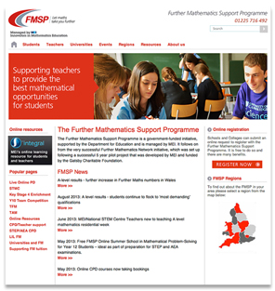
The Further Mathematics Support Programme
The FMSP aims is to increase the uptake of AS and A level Further Mathematics to ensure that more students reach their potential in mathematics.
The FMSP website has further advice on studying A level Mathematics and Further Mathematics, enrichment resources for students and information on applying to university.
To find out more visit www.furthermaths.org.uk

